Slide 1
Application of Soft Computing
Shreya

Slide 2
Neural Network
ANN is functional unit of Deep Learning.
Deep learning uses ANN which mimic the behaviour of human brain to solve complex problem.
Deep learning in itself is a part of machine learning which falls under the umbrella of artificial intelligence.
AI, ML and DL are interconnected fields. ML and DL aids AI by providing a set of algorithms and NN to solve data driven problems. Deep learning makes use of ANN that behaves same as human brain.
Neural network means a network (Interconnections) of neurons which is not natural i.e. artificial.
Mimic the behaviour of human brain to solve complex data driven problems.
They are doing processing and sharing of information
Neural Network------------> ANN
Objective is Learning and Adaption
Healthcare, Speech Recognition, Face Recognition and Marketing, Google Translator, Self driven cars

Slide 3
WHY ANN?
Neural networks, with their remarkable ability to derive meaning from complicated or imprecise data, can be used to extract patterns and detect trends that are too complex to be noticed by either humans or other computer techniques.
A trained neural network can be thought of as an "expert" in the category of information it has been given to analyse. This expert can then be used to provide predictions given new situations

Slide 4
Other Advantages
Adaptive learning: An ability to learn how to do tasks based on the data given for training or initial experience.
Self-Organisation: An ANN can create its own organisation or representation of the information it receives during learning time.
Real Time Operation: ANN computations may be carried out in parallel, and special hardware devices are being designed and manufactured which take advantage of this capability.
Fault Tolerance via Redundant Information Coding: Partial destruction of a network leads to the corresponding degradation of performance. However, some network capabilities may be retained even with major network damage.

Slide 5
Biological Neuron
Biological nervous system is the most important part of many living things, in particular, human beings.
There is a part called brain at the center of human nervous system.
In fact, the human brain is a highly complex structure viewed as a massive, highly interconnected network of simple processing elements called neurons.
In fact, any biological nervous system consists of a large number of interconnected processing units called neurons.
Each neuron is approximately 10µm long and they can operate in parallel.

Slide 6
Human Brain
The human brain is the command centre for the human nervous system. It receives input from the sensory organs and sends output to muscles.
Typically, a human brain consists of approximately 10¹¹ neurons communicating with each other with the help of electrical impulses transmission.
An average brain weight about 1.5 kg and for neuron its 1.5*10-9 gms.
Only some neurons are performing input output operations while others are busy in transforming signal and storing information.

Slide 7
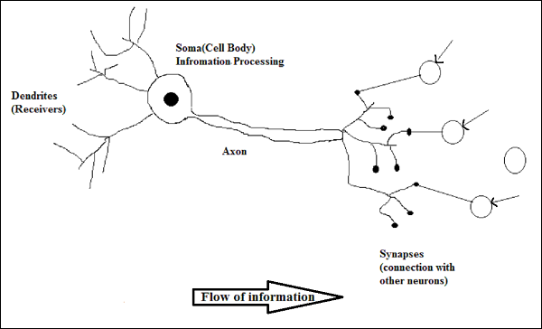
Neuron Architecture

Slide 8
Cont...
Soma: It is also called a cell body, and contains the nucleus of cell which controls the entire neuron. It processes the information.
Dendrite: Attached to Soma, A bush of very thin fiber, irregular in shape, receives signals from other neurons. All inputs from other neurons can only receive through Dendrite.(Looks like a branch of tree in winter)
Axon : A long cylindrical fiber or just like a cable through which neurons send the information.
synapse: It is a junction where axon makes contact with the dendrites of neighboring dendrites. i.e. point of connection to other neurons

Slide 9
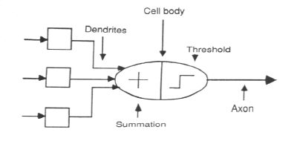
Artificial neuron

Slide 10
Neuron and its working
There is a chemical in each neuron called neurotransmitter which is responsible for accelerating the electrical charges to soma.
A signal (also called sense) is transmitted across neurons by this chemical.
That is, all inputs from other neuron arrive to a neurons through dendrites.
These signals are accumulated at the synapse of the neuron and then serve as the output to be transmitted through the neuron.
An action may produce an electrical impulse, which usually lasts for about a millisecond.

Slide 11
Cont...
When a neuron receives excitationary input i.e. sufficiently large compared with its inhibitory input, it sends a spike of electrical activity down to axon.
Note that this pulse generated due to an incoming signal and all signal may not produce pulses in axon unless it crosses a threshold value.
Also, note that an action signal in axon of a neuron is cumulative signals arrive at dendrites which summed up at soma.

Slide 12
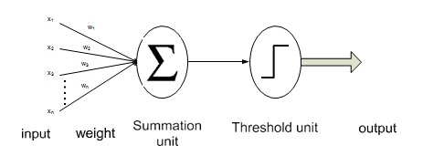
Mathematical Model of ANN
A neural network is a system composed of many simple processing elements operating in parallel whose function is determined by network structure, connection strengths, and the processing performed at computing elements or nodes.

Slide 13
Cont...
The artificial neuron given in this figure has N input, denoted as x₁, x₂, ... x_{n}.
Each line connecting these inputs to the neuron is assigned a weight, which are denoted as w₁, w₂, .., w_{n} respectively.
Weights in the artificial model correspond to the synaptic connections in biological neurons.
The threshold in artificial neuron is usually represented by θ and the activation corresponding to the graded potential is given by a formula.

Slide 14
Cont...
The inputs and the weights are real values. A negative value for a weight indicates an inhibitory connection while a positive value indicates an excitatory one.
The total input I received at soma of the Artificial neuron
I=w₁x₁+ w₂x₂+ w₃x₃+........+w_{n}x_{n}
= ∑w_{i}x_{i} ………………………(i)
To generate the final output y, the sum is passed on to a non linear filter Φ called activation function or transfer function or squash function.
Y= Φ (I)..................(ii)

Slide 15
A very commonly known transfer function is the
thresholding function.
In this thresholding function, sum (i.e. I) is compared
with a threshold value θ.
If the value of I is greater than θ, then the output is 1 else
it is 0 (this is just like a simple linear filter).

Slide 16
ARTIFICIAL NEURAL NETWORK
Information-processing system.
Neurons process the information.
The signals are transmitted by means of connection links.
The links possess an associated weight.
The output signal is obtained by applying activations to the net input.

Slide 17
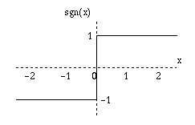
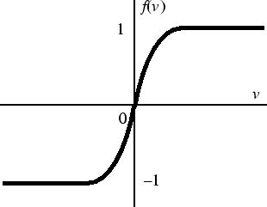
Activation Functions
Controls when unit is “active” or “inactive”
Threshold function outputs 1 when input is positive and 0 otherwise.
Φ (I)={1 if I>= Θ else 0
Sigmoid function
Φ (I)= 1 / (1 + e^{-I})
Identity function Φ (I)=I

Slide 18
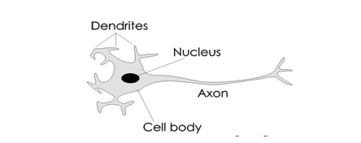
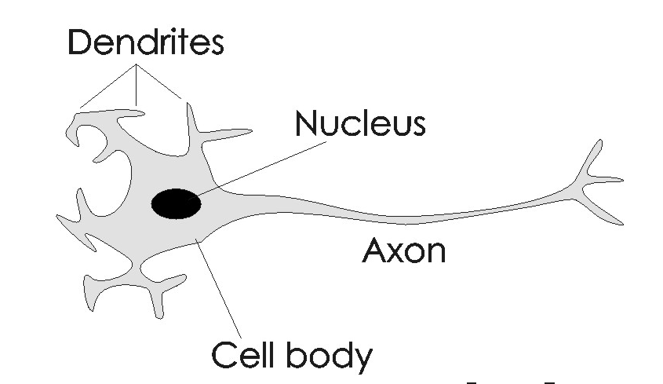
Analogy between BNN and ANN
Terminology Relationship Between ANN and BNN
BNN | ANN
Cell | Neuron
Dendrite | Weights or interconnections
Soma | Net input
Axon | Output

Slide 19
Every component of this model bears a direct analogy to actual constituents of biological neuron & hence is termed as Artificial Neuron.
Artificial Neural Network ANN is an efficient computing system whose central theme is borrowed from the analogy of biological neural networks.
Artificial neural networks (ANNs) or simply we refer it as neural network (NNs), which are simplified models (i.e. imitations) of the biological nervous system, and obviously, therefore, have been motivated by the kind of computing performed by the human brain.

Slide 20
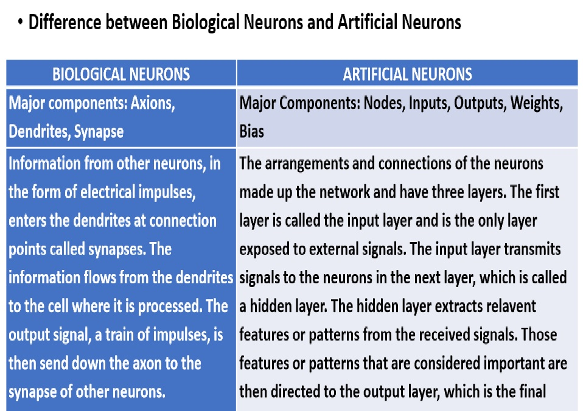

Slide 21
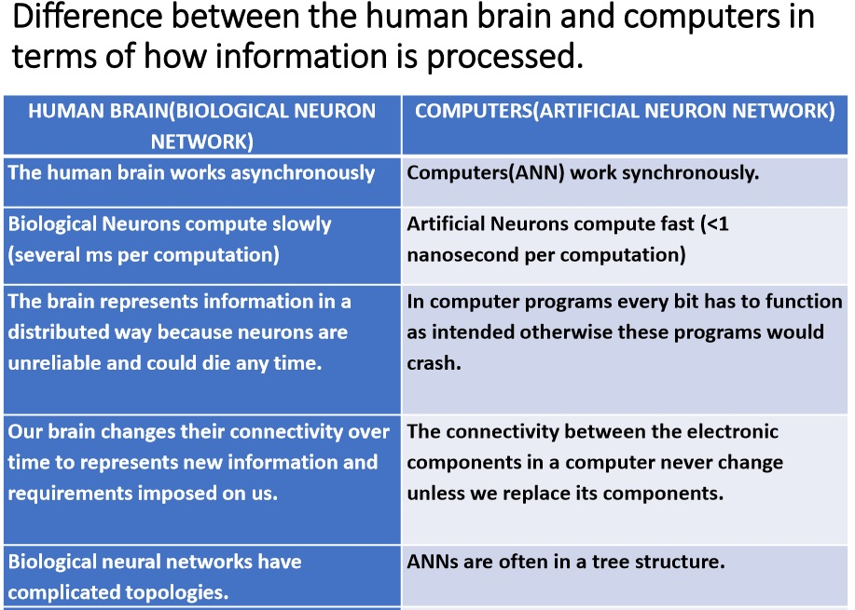

Slide 22
Comparison between ANN and BNN
Criteria | BNN | ANN
Processing | Massively parallel, slow but superior than ANN | Massively parallel, fast but inferior than BNN
Size | 10¹¹ neurons and 10¹⁵ interconnections | 10² to 10⁴ nodes Depends on the designer
Learning | They can tolerate ambiguity | Very precise, structured and formatted data is required to tolerate ambiguity
Fault tolerance | Performance degrades with even partial damage | It is capable of robust performance, hence has the potential to be fault tolerant
Storage capacity | Stores the information in the synapse | Stores the information in continuous memory locations

Slide 23
Characteristics of ANN
It is naturally implemented mathematical model.
Knowledge is acquired by the network through a learning process.
Inter neuron connection strengths known as synaptic weights are used to store the knowledge.
The amazing thing about a neural network is that you don't have to program it to learn explicitly: it learns all by itself, just like a brain!
The processing elements of the ANN have the ability to learn, recall and generalize from the given data by suitable assignment or adjustment of weights.

Slide 24
Cont…
The computational power can be demonstrated only by the collective behavior of neurons, and should be noted that no single neuron carries specific information.
The ability to learn from experience in order to improve their performance.
Ability to deal with incomplete information.
A powerful technique to solve many real world problems.
The ability to learn from experience in order to improve their performance.

Slide 25
Types of Neural Networks
Neural Network types can be classified based on following attributes:
Connection Type
Static (feed forward)
Dynamic (feedback)
Topology
Single layer
Multilayer
Recurrent

Slide 26
Neural Network architectures
An ANN structure can be represent using a directed graph i.e. G(V,E). Diagraph assume significance in NN since signals in NN are restricted to flow in one direction. There are three fundamental classes of ANN architectures:
Single layer feed forward architecture
Multilayer feed forward architecture
Recurrent networks architecture

Slide 27
Feedforward Network
It is a non-recurrent i.e. A feed forward neural network is an ANN wherein connections between the units do not form a cycle.
In this network, the information moves in only one direction, forward, from the input nodes, through the hidden nodes (if any) and to the output nodes.
Network having processing units/nodes in layers and all the nodes in a layer are connected with the nodes of the previous layers.
The connection has different weights upon them.
It may be divided into the following two types

Slide 28
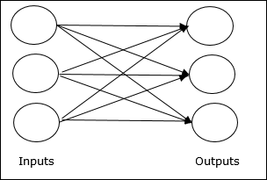
Single layer feed forward network
Single layer feed forward network − There are only two layers one is input layer and other one is output layer.
Links carrying weights connect every input neuron to output neuron but not vice versa.
Single layer named because only the output layer performs the computation. Input layer is only transmitting the input signals to output layer.

Slide 29
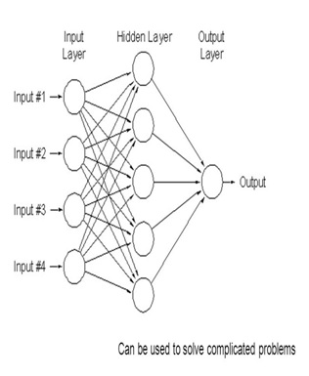
Multi layer feed forward network
This type of ANN having more than one weighted layer. As this network has one or more layers between the input and the output layer, it is called hidden layers.
One or more intermediate layers called hidden layers & respective neurons called hidden neurons.

Slide 30
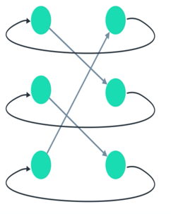
Recurrent networks architecture
Recurrent Neural Network(RNN) are a type of Neural Network where the output from previous step are fed as input to the current step.
At least one feedback loop must exist.

Slide 31
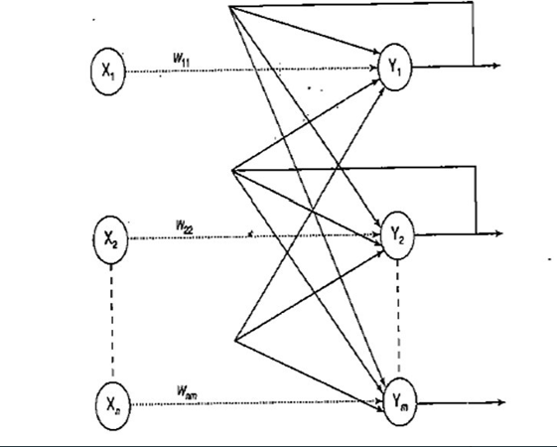
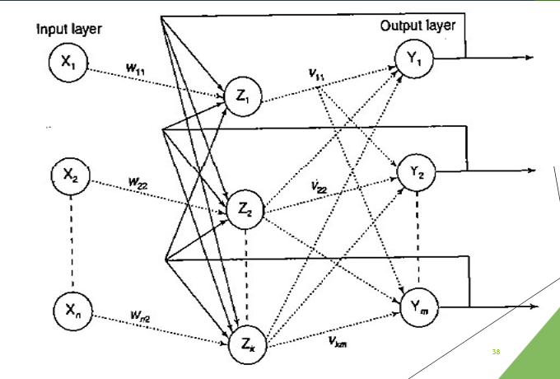
Recurrent network
Single-layer recurrent network
Multilayer recurrent network

Slide 32
Perceptron
A single layer perceptron (SLP) is a feed-forward network based on a threshold transfer function. SLP is the simplest type of artificial neural networks and can only classify linearly separable cases with a binary target (1 , 0).
The perceptron is simply separating the input into 2 categories, those that cause a fire, and those that don't.

Slide 33
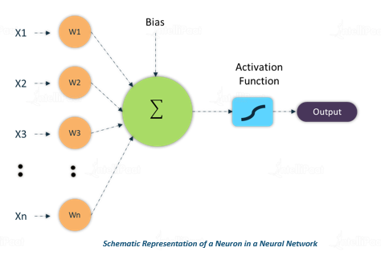
Bias in Neural Network

Slide 34
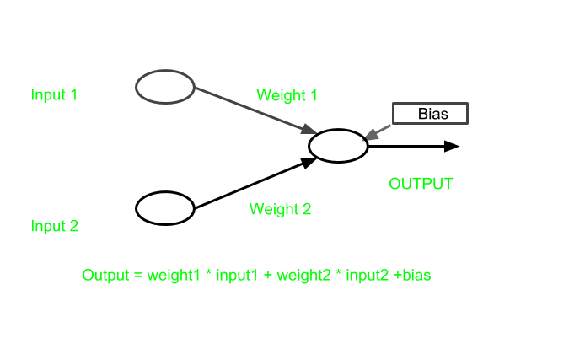
It is an additional parameter in the Neural Network which is used to adjust the output along with the weighted sum of the inputs to the neuron. Therefore Bias is a constant which helps the model in a way that it can fit best for the given data.
The processing done by a neuron is thus denoted as: output = sum (weights * inputs) + bias

Slide 35
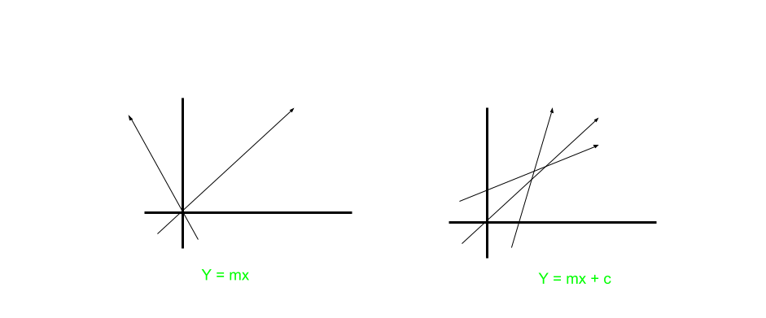
Let us take example of line equation y=mx+c. Now, Suppose if c was absent, then the graph will be formed like this:
Due to absence of bias, model will train over point passing through origin only, which is not in accordance with real-world scenario. Also with the introduction of bias, the model will become more flexible.

Slide 36
Bias helps in controlling the value at which activation function will trigger.
The Bias neuron is a special neuron added to each layer in the neural network, which simply stores the value of 1. This makes it possible to Control the activation function.
Without a Bias neuron, each neuron takes the input and multiplies it by a weight, with nothing else added to the equation.
Bias acts like a constant which helps the model to fit the given data.

Slide 37
Linearly Separable Problems
The output values of a perceptron can take on only one of two values (0 or 1) due to the hard-limit transfer function.
Perceptrons can only classify linearly separable sets of vectors. If a straight line or a plane can be drawn to separate the input vectors into their correct categories, the input vectors are linearly separable. If the vectors are not linearly separable, learning will never reach a point where all vectors are classified properly.
The Boolean function XOR is not linearly separable (Its positive and negative instances cannot be separated by a line or hyperplane).

Slide 38
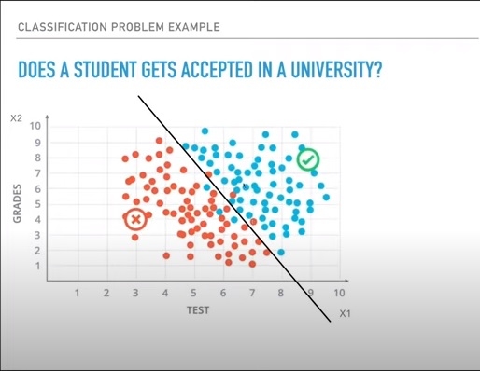

Slide 39
Learning in ANN
One of the most impressive features of artificial neural networks is their ability to learn.
Inspired by the biological nervous system, in particular, the human brain. One of the most interesting characteristics of the human brain is it's ability to learn.
It is believed that during the learning process the brain's neural structure is altered, increasing or decreasing the strength of it's synaptic connections depending on their activity.
More relevant information will have stronger synaptic connections and less relevant information will gradually have it's synaptic connections weaken.

Slide 40
Types of Learning in ANN
The objective is to find a set of weight matrices which when applied to the network should hopefully map any input to a correct output.
Lets take a quick look at the three major learning paradigms.
Supervised Learning
Unsupervised Learning
Reinforcement Learning

Slide 41
Supervised Learning
Every input pattern that is used to train the network is associated with an output pattern, which is the target or desired pattern.
A teacher is assumed to be present during the learning process, when a comparison is made between network’s computed output and correct output to determine the error.
The error then can be used to change network weight which result in an improvement in performance.
Applications are like BioInformatics, Speech Recognition and Spam Detection.

Slide 42
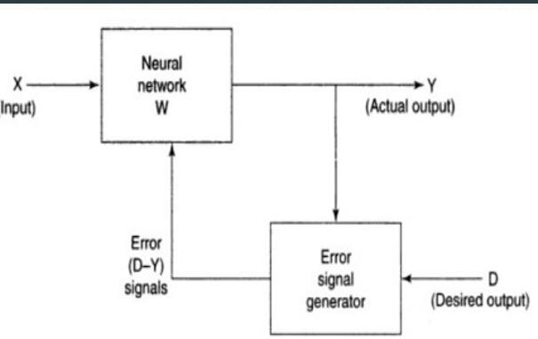
Supervised Learning

Slide 43
Unsupervised Learning
Target output is not present in the network.
It is as if there is no teacher to present the desired pattern and hence the system learns by its own by discovering and adapting to structural features in input pattern.
In this paradigm the neural network is only given a set of inputs and it's the neural network's responsibility to find some kind of pattern within the inputs provided without any external aid.
This type of learning paradigm is often used in data mining and is also used by many recommendation algorithms due to their ability to predict a user's preferences based on the preferences of other similar users it has grouped together.
Some of the applications are like Clustering automatically split the dataset into groups base on their similarities.

Slide 44
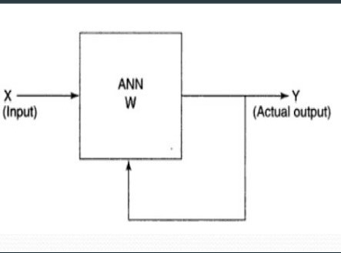
Unsupervised learning

Slide 45
Reinforcement Learning
Reinforcement learning is similar to semi-supervised learning in that a teacher though available but doesnot present the expected output but only indicated if the computed output is correct or incorrect.
The information provided helps the network in learning process.
A reward is given for a correct answer computed and penalty for a wrong answer.
Applications are like Traffic Light Control, Robotics and Games

Slide 46
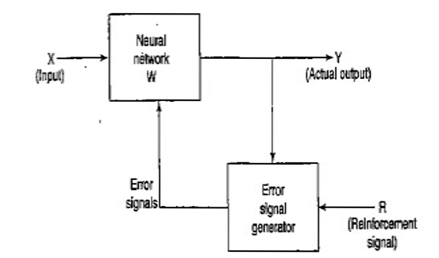
Reinforcement Learning

Slide 47
Example of Reinforcement Learning
Imagine a baby is given a TV remote control at your home (environment). In simple terms, the baby (agent) will first observe and construct his/her own representation of the environment (state). Then the curious baby will take certain actions like hitting the remote control (action) and observe how would the TV response (next state). As a non-responding TV is dull, the baby dislike it (receiving a negative reward) and will take less actions that will lead to such a result(updating the policy) and vice versa. The baby will repeat the process until he/she finds a policy (what to do under different circumstances) that he/she is happy with (maximizing the total (discounted) rewards).

Slide 48
Learning Rule
Basically, learning means to do and adapt the change in itself as and when there is a change in environment.
The importance of learning in ANN increases because of the fixed activation function as well as the input/output vector, when a particular network is constructed. Now to change the input/output behaviour, we need to adjust the weights.
Hence, a method is required with the help of which the weights can be modified. These methods are called Learning rules, which are simply algorithms or equations. Following are some learning rules for the neural network : Hebbian Learning Rule & Perceptron Learning Rule

Slide 49
Hebbian Learning Rule
It is a kind of feed-forward, unsupervised learning. This rule, one of the oldest and simplest, was introduced by Donald Hebb.
Hebbian Learning is very similar to the physical changes in our brain while we learn anything new.
“When an axon of cell A is near enough to excite a cell B and repeatedly or persistently takes part in firing it, some growth process or metabolic change takes place in one or both cells such that A’s efficiency, as one of the cells firing B, is increased.”

Slide 50
Cont...
we can conclude that the connections between two neurons might be strengthened if the neurons fire at the same time and might weaken if they fire at different times.
According to Hebbian learning rule, following is the formula to increase the weight of connection at every time step.
The weight update in Hebb rule is given by
w_{i}(new)= w_{i}(old)+x_{i}y

Slide 51
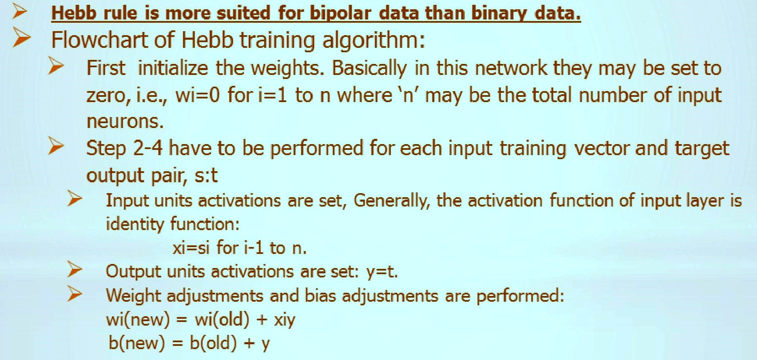
Algorithm
* Set s to input units
*Set output unit t to y

Slide 52
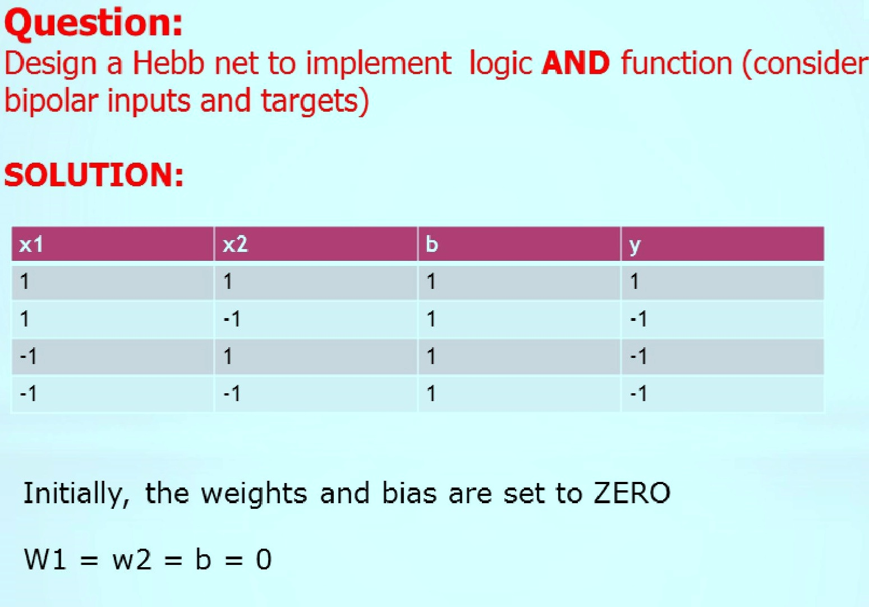
Implementation

Slide 53
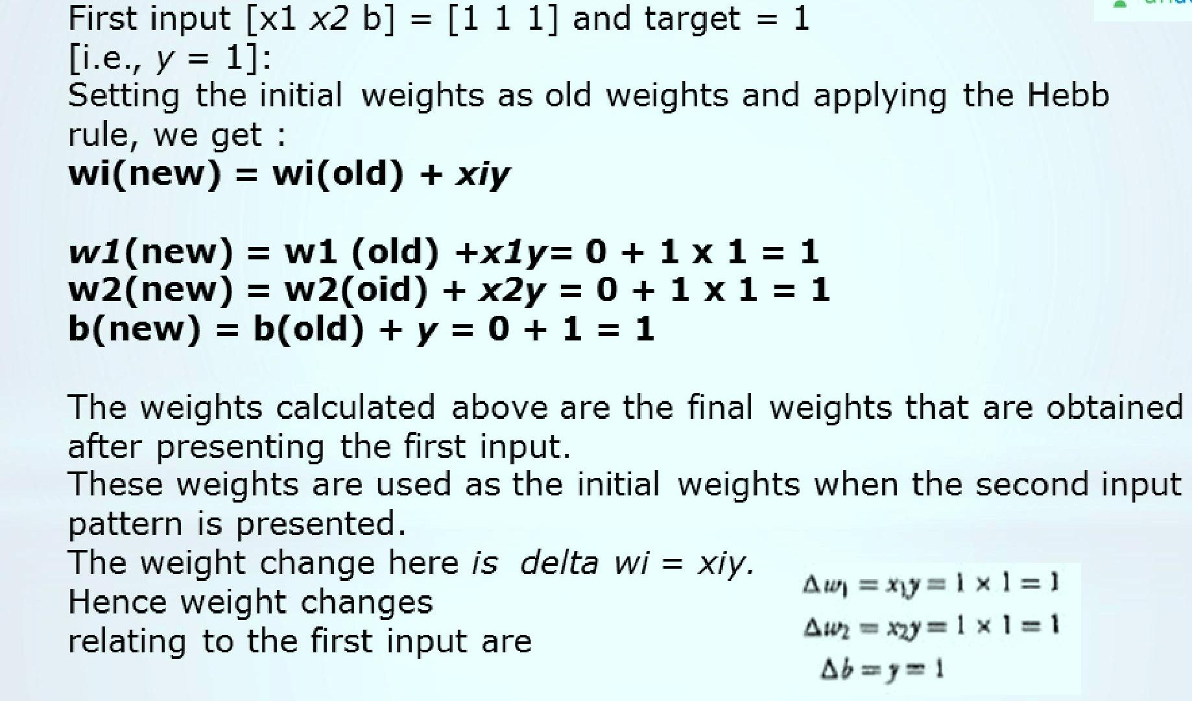
Cont...

Slide 54
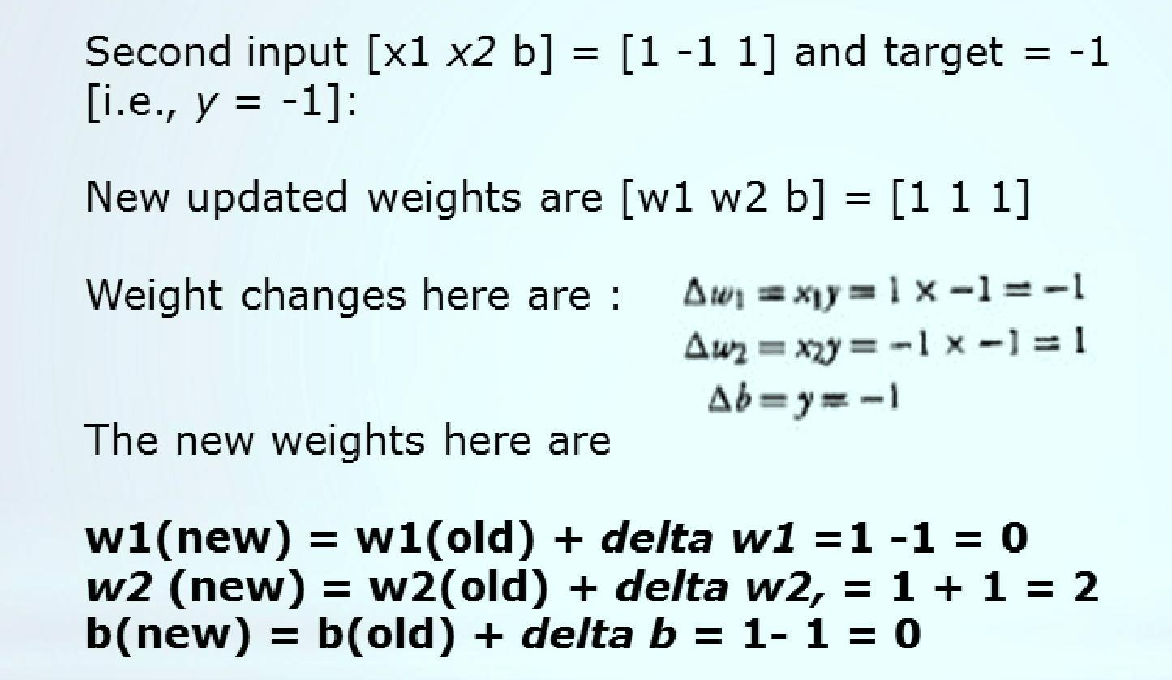
Cont...

Slide 55
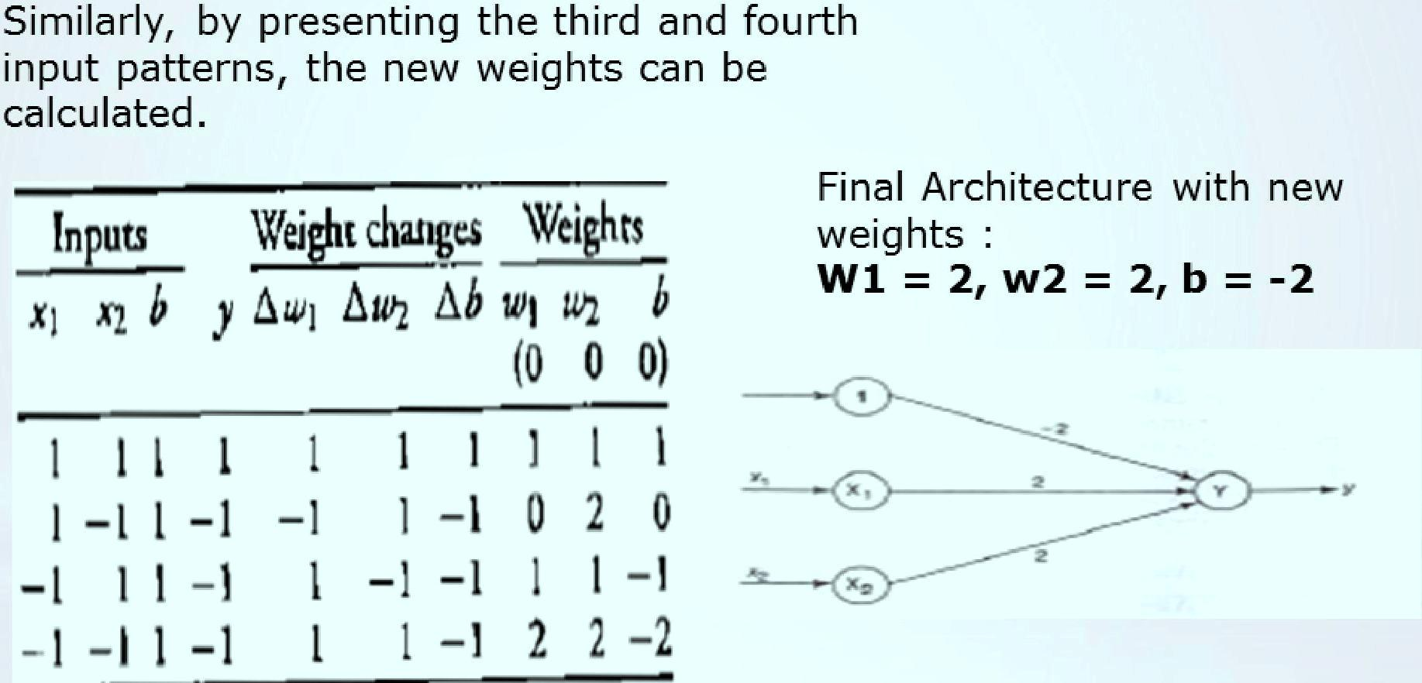
Cont...

Slide 56
Example of Hebb Learning
Using hebb rule, find the weights required to perform the following classification of the given input.
(I) (O)
(I) (O)
+ symbol indicate the value 1 and empty squares indicates -1.
(I) belongs to the member of class while (O) doesn’t belong to member of class.
+ | + | +
 | +
+ | + | +
+ | + | +
+ |  | +
+ | + | +

Slide 57


Perceptron Learning Rule
The output is Y= f (y) Y= Φ(I)
The activation function is:
The weight updation takes place to match the target output. The error is calculated based on the actual output and the desired output.

Slide 58
Modelling Neurons
We have discussed the perceptron algorithm which was invented in 1958 by Frank Rosenblatt, only capable of learning linearly separable patterns.
After that we have also discussed about another model of Neural network leaning i.e. Hebbian learning which was invented in 1949, based on based on the self organized learning.
Now we are going to discuss another model of Neural network which is given by Warren McCulloch and Walter Pitts in 1943.
It is the first mathematical model for modelling biological neurons.

Slide 59
Evolution of Neural Network
Year | Neural network | Designer | Description
1943 | McCulloch and Pitts | McCulloch and Pitts | Arrangement of
 | neuron |  | neurons is
 |  |  | combination of logic
 |  |  | gate. Unique feature
 |  |  | is thresh hold
1949 | Hebb network | Hebb | If two neurons are
 |  |  | active, then their
 |  |  | connection strengths
 |  |  | should be increased.
1958,1959,1962,1988,1 | Perceptron | Frank Rosenblatt, | Weights are adjusted
960 | Adaline | Block, Minsky and | to reduce the
 |  | Papert Widrow and | difference between
 |  | Hoff | the net input to the
 |  |  | output unit and the
 |  |  | desired output

Slide 60
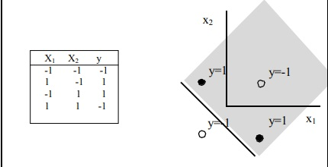
Limitations of the perceptron :The prototype problem that is not linearly separable and thus cannot be solved by perceptrons is the exclusive-or function (XOR).

Slide 61
McCulloch-Pitts Neuron
The McCulloch-Pitts neuron was the earliest neural network discovered in 1943.
It is usually called as M-P neuron.
The M-P neurons are connected by directed weighted paths.
The activation of a M-P neuron is binary, that is, at any time step the neuron may fire or may not fire.
The weights associated with the communication links may be excitatory (weight is positive) or inhibitory (weight is negative).
The threshold plays a major role in M-P neuron. There is a fixed threshold for each neuron, and if the net input to the neuron is greater than the threshold then the neuron fires.
Also, it should be noted that any nonzero inhibitory input would prevent the neuron from firing.
The M-P neurons are most widely used in the case of logic functions.

Slide 62
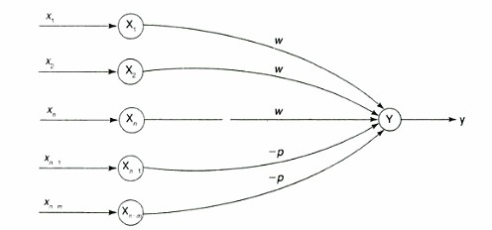

Cont...
A simple M-P neuron is shown in the figure.
It is excitatory with weight (w>0) / inhibitory with weight
–p (p<0).
In the Fig., inputs from x₁ to x_{n} possess excitatory weighted connection and X_{n+1} to x_{n+m} has
inhibitory weighted interconnections.
Since the firing of neuron is based on threshold, activation function is defined as

Slide 63
Cont...
If inhibitory weights are used than threshold with activation function should satisfy the following condition: Θ > nw – p where n is the no. of input, w is number of excitatory weights and p is number of inhibitory weights.
The prototype problem that is not linearly separable and thus cannot be solved by single layer perceptrons is the exclusive-or function (XOR).
Now we are going to solve Ex-OR problem using McCulloch Pitts Model.

Slide 64
Associate Memory Network
Associative memory is defined as the ability to learn and remember the relationship between unrelated items. for example, remembering the name of someone or the aroma of a particular perfume.
This can be considered as simplified model of human brain which can associate similar patterns. Like faces with names, letters with sounds etc.
An Associative memory is a storehouse of associated patterns which are encoded in some form. When the storehouse is triggered with a pattern, the associated pair is recalled as output.

Slide 65
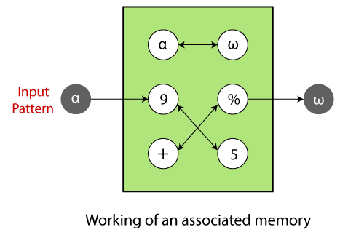
Cont...
Associative memories are neural networks (NNs) for modeling the learning and retrieval of memories in the brain. The retrieved memory and its query are typically represented by binary, bipolar, or real vectors describing patterns of neural activity.

Slide 66
Learning is the process of forming associations between related patterns.
The patterns we associate together may be of the same type or of different types.
Each association is an input-output vector pair, s:t.
If each vector t is the same as the vector s with which it is associated, then the net is called an autoassociative memory.
If the t's are different from the s's, the net is called a heteroassociative memory.

Slide 67
Associative memory is content addressable memory
The words are accessed based on the content of the key vector
When the network is excited by a portion of the stored date, the efficient response of autoassociative memory is the completed x (i) vector
In hetroassociative memory the content of x (i) provides the stored vector v (i)
There is no storage for prototype x (i) or v (i) at any location of network

Slide 68
The entire mapping is distributed in the network.
The mapping is implemented through dense connections, feedback or/and a nonlinear thresholding operation
In each of these cases, the net not only learns the specific pattern pairs that were used for training, but also is able to recall the desired response pattern when given an input stimulus that is similar, but not identical, to the training input.

Slide 69
HEBB RULE FOR PATTERN ASSOCIATION
Algorithm (bipolar or binary patterns):
For each training samples s:t:
are ON (binary) or have the same sign (bipolar).
Instead of obtaining W by iterative updates, it can be computed from the training set by calculating the outer product of s and t.

Slide 70
OUTER PRODUCT FOR PATTERN ASSOCIATION
Let s and t be row vectors.
Then for a particular training pair s:t
and

Slide 71
HETERO-ASSOCIATIVE MEMORY NETWORK
Binary pattern pairs s:t with |s| = 4 and |t| = 2.
Total weighted input to output units:
Activation function: threshold
Weights are computed by Hebbian rule (sum of outer products of all training pairs)
Training samples:
s(p) t(p)
p=1 (1 0 0 0) (1, 0)
p=2 (1 1 0 0) (1, 0)
p=3 (0 0 0 1) (0, 1)
p=4 (0 0 1 1) (0, 1)

Slide 72
COMPUTING THE WEIGHTS

Slide 73
TEST/ RECALL THE NETWORK
(1 0 0 0), (1 1 0 0) class (1, 0)
(0 0 0 1), (0 0 1 1) class (0, 1)
(0 1 1 0) is not sufficiently similar to any class so it provides different output class.

Slide 74
AUTO-ASSOCIATIVE MEMORY NETWORK
Same as hetero-associative nets, except t(p) =s (p).
Used to recall a pattern by a its noisy or incomplete version. (pattern completion/pattern recovery)
A single pattern s = (1, 1, 1, -1) is stored (weights computed by Hebbian rule or outer product rule.

Slide 75
ADALINE Neural Network
ADALINE which stands for Adaptive Linear Neuron, developed by Widrow and Hoff in 1960. ADALINE is a network having a single linear unit.Some important points about ADALINE are as follows −
It uses bipolar activation function.
It uses delta rule for training to minimize the Mean-Squared Error (MSE) between the actual output and the target output.
The weights and the bias are adjustable.
Use of supervised Learning

Slide 76
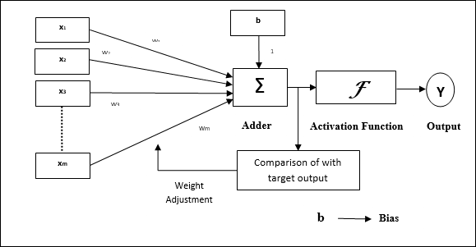
Cont..
In ADALINE, the weights are updated based on a linear activation function. φ(wTx) = wTx
The learning algorithm used by ADALINE is known as least mean square or Delta Rule.

Slide 77
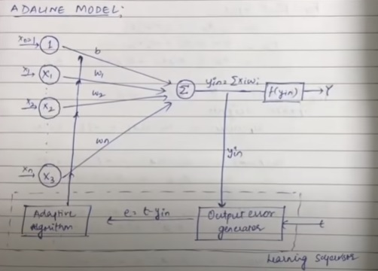
Cont...
Error can be calculated as mean square error E=(t-y_{in})²

Slide 78
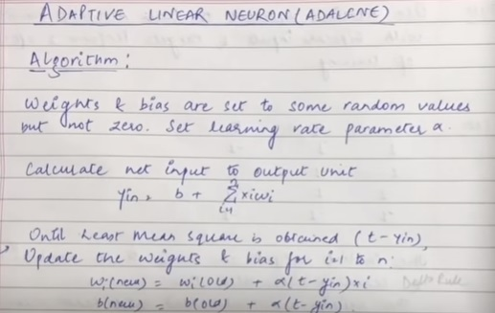
Algorithm
One important thing is that the error is calculated on the net input not on the actual output.
Application: Widely used in all high speed modems and telephone switching system to cancel the echo in long distance communication circuits.

Slide 79
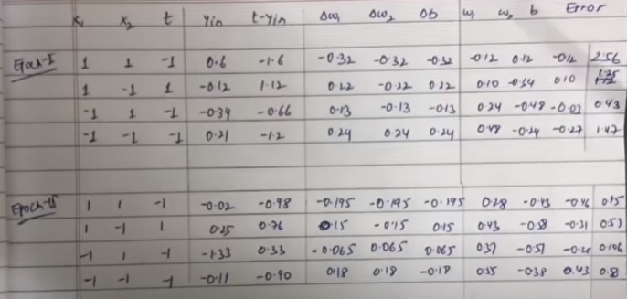
Use Adaline network to train ANDNOT function with bipolar inputs and targets. Perform 2 Epochs of training.
Consider w1=w2=b=0.2 and α=0.2

Slide 80
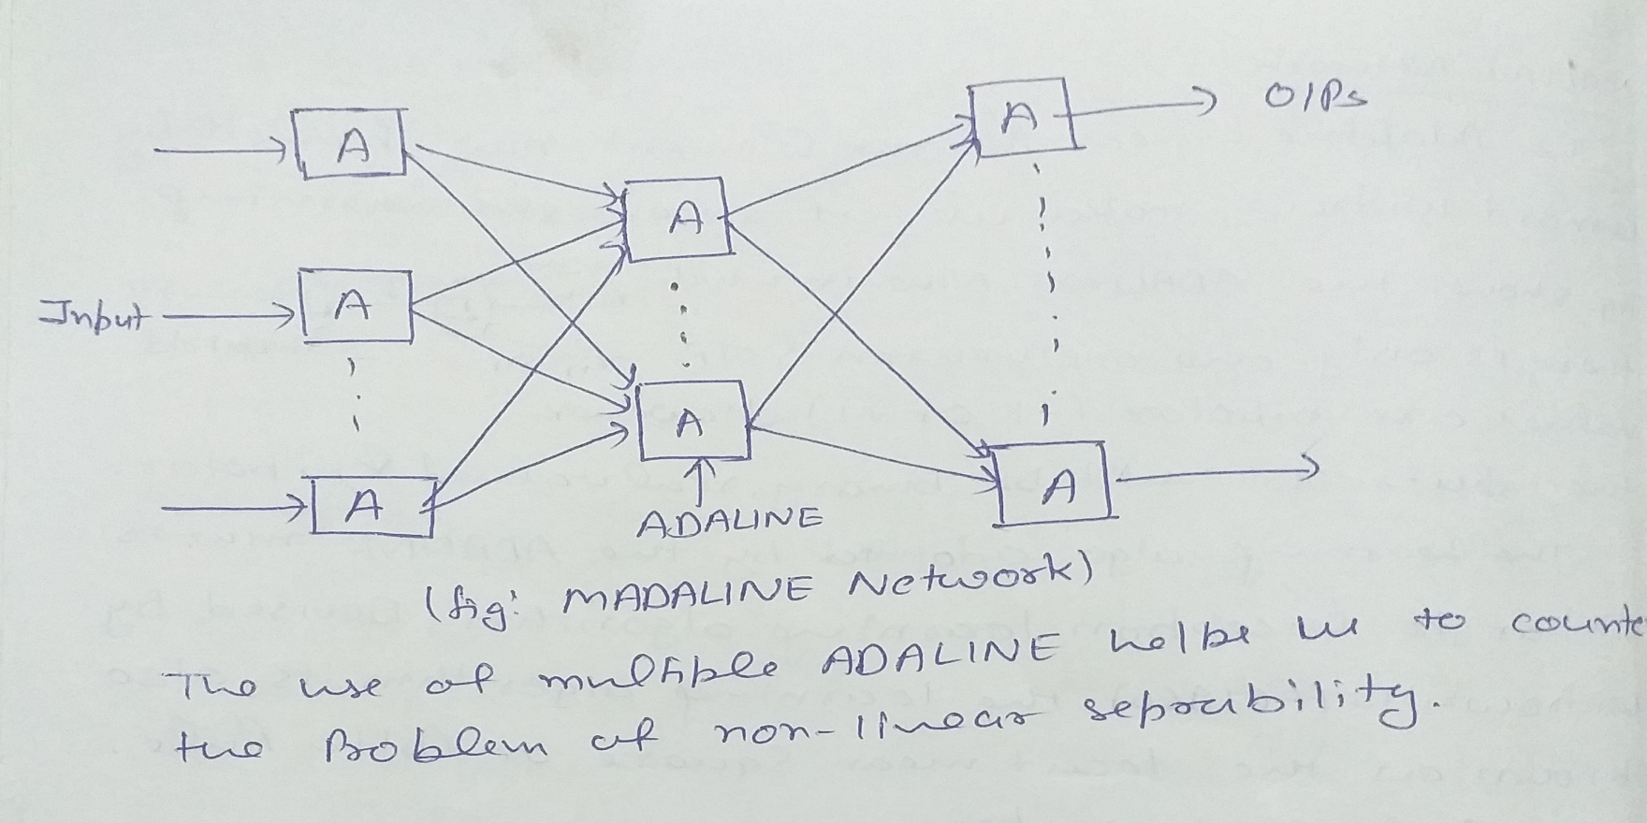
MADALINE Network
MADALINE stands for Many ADALINE created by combining many ADALINE networks.

Slide 81
Associative memory Numerical
A1=[1 0 0 0 0 1] B1=[1 1 0 0 0]
A2=[0 1 1 0 0 0 ] B2=[1 0 1 0 0 ]
A3=[ 0 0 1 0 1 1 ] B3= [0 1 1 1 0]
A1,A2 AND A3 ARE INPUTS AND B1 B2 B3 ARE THE OUTPUTS RESPECTIVELY
CHANGE THE INPUT OUTPUT TO BIPOLAR
AS X1 AND Y1
(i)Find the final weight matrix
(ii)Check the network for the pattern
[0 0 1 0 1 1]
(iii) Predict the output for the pattern [ 1 1 1 0 0 0 ]

Slide 82
1 1 -3 – 1 1
1 -3 1 -1 1
-1 -1 3 1 -1
-1 -1 -1 1 3
-3 1 1 3 1
-1 3 -1 1 -1

